Slide 1
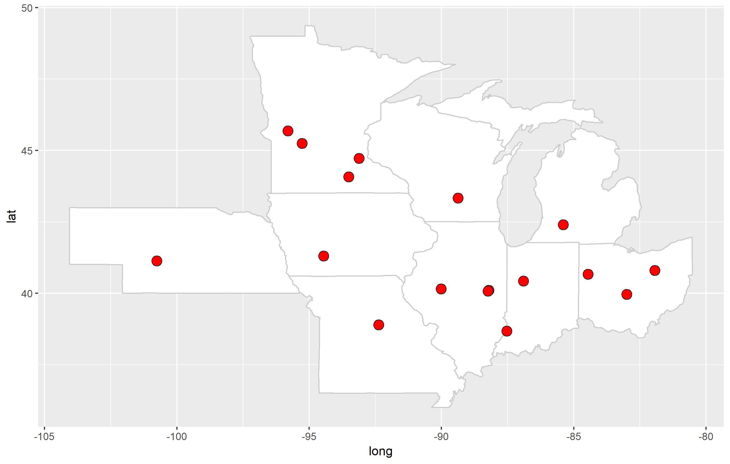
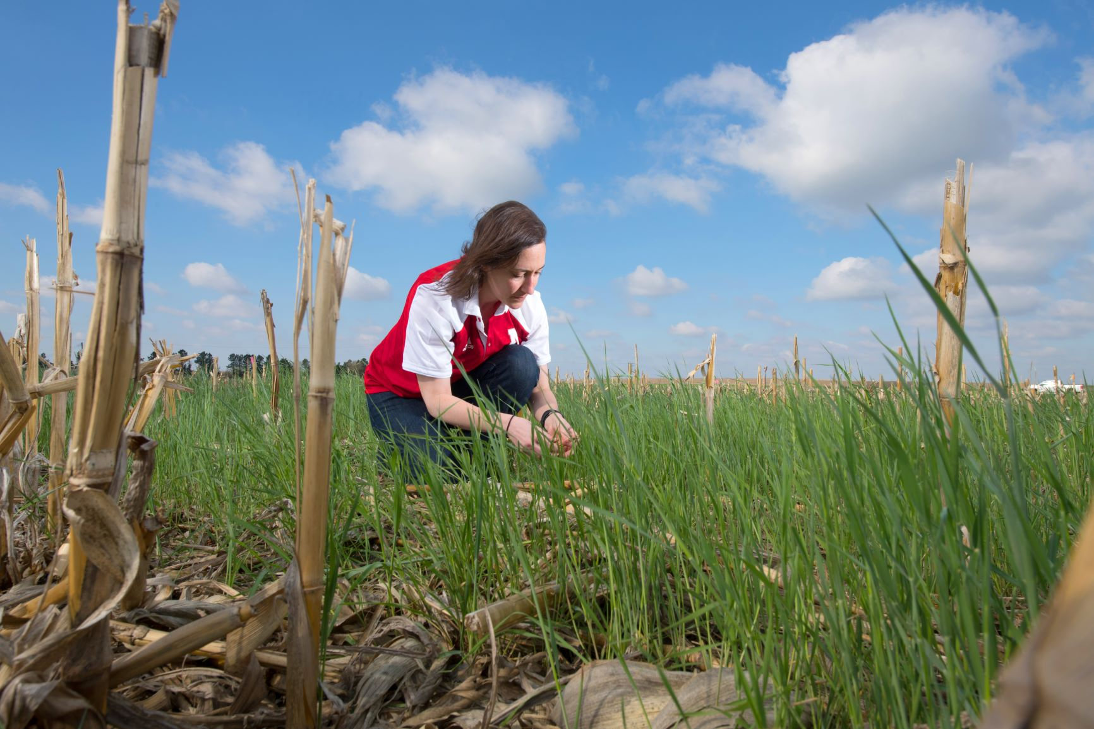
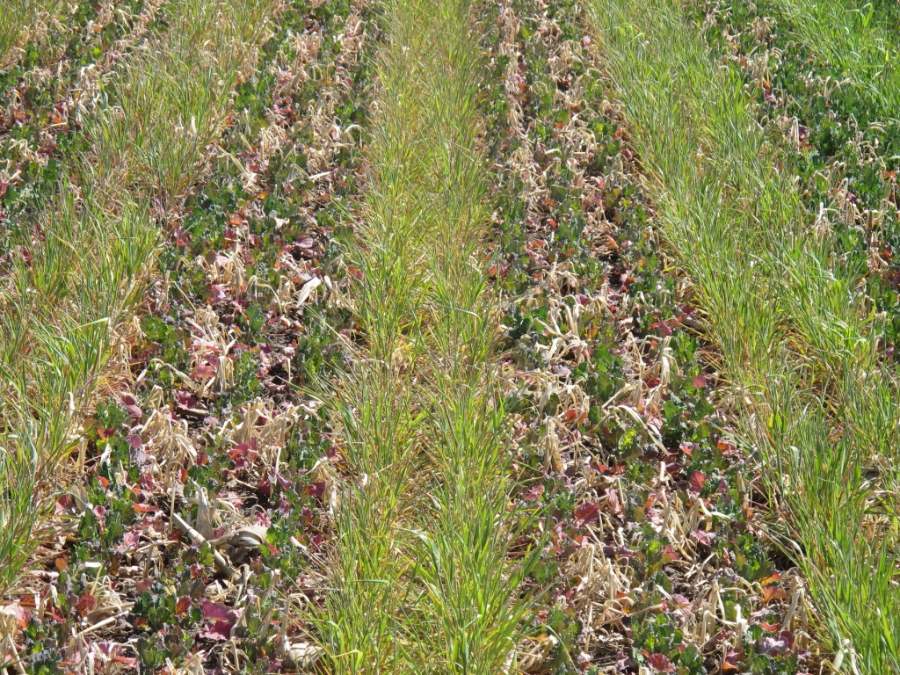
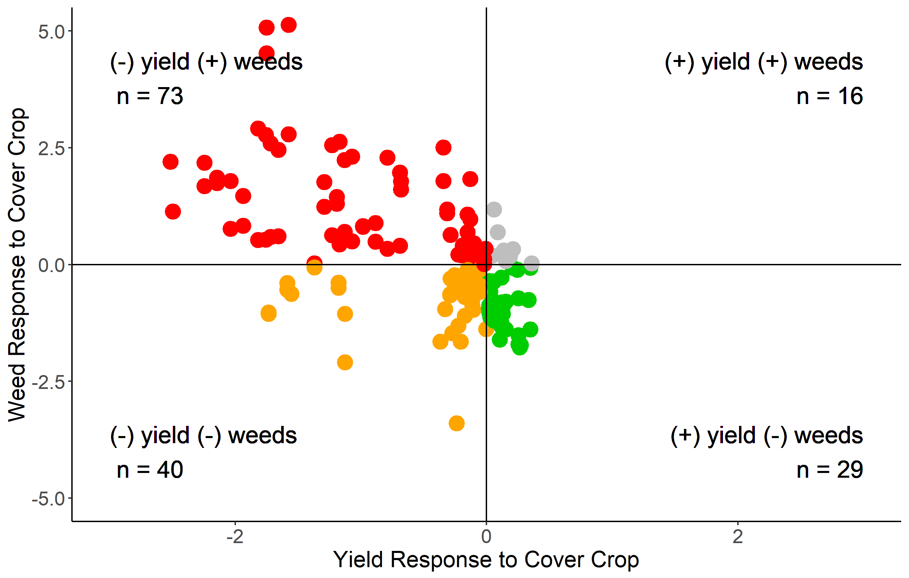
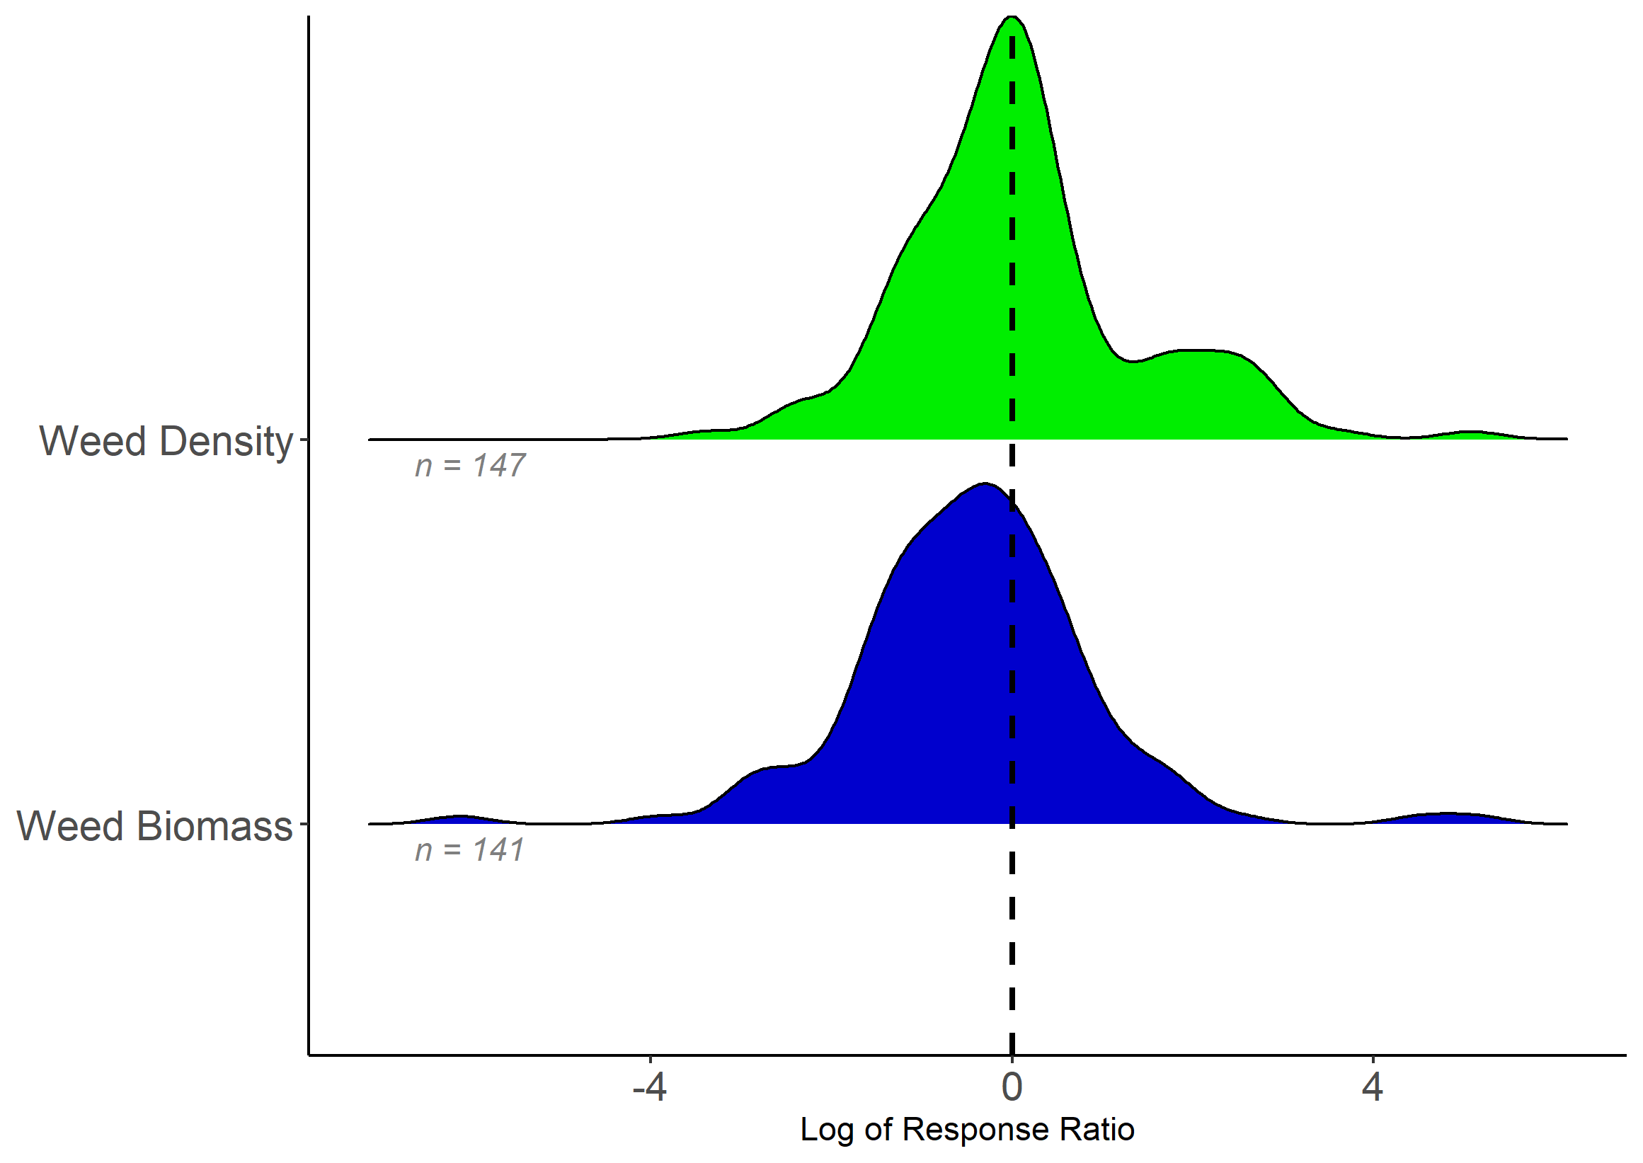
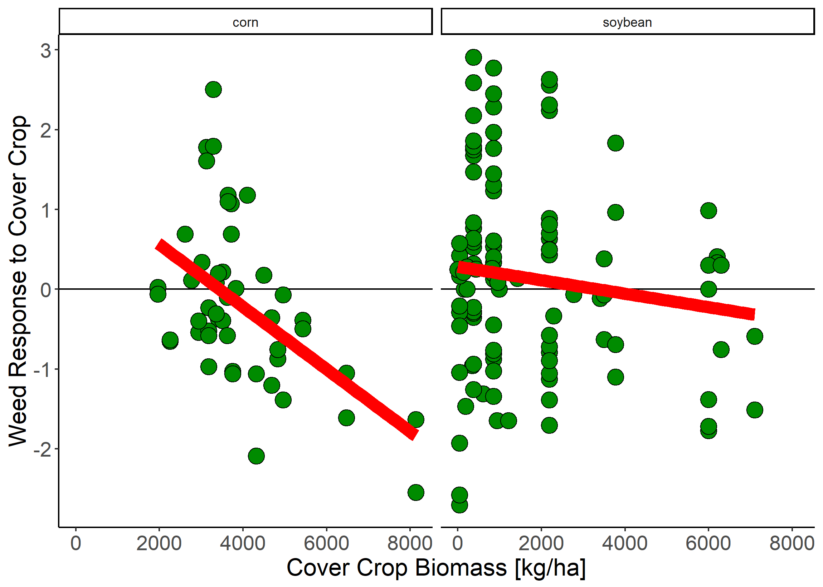
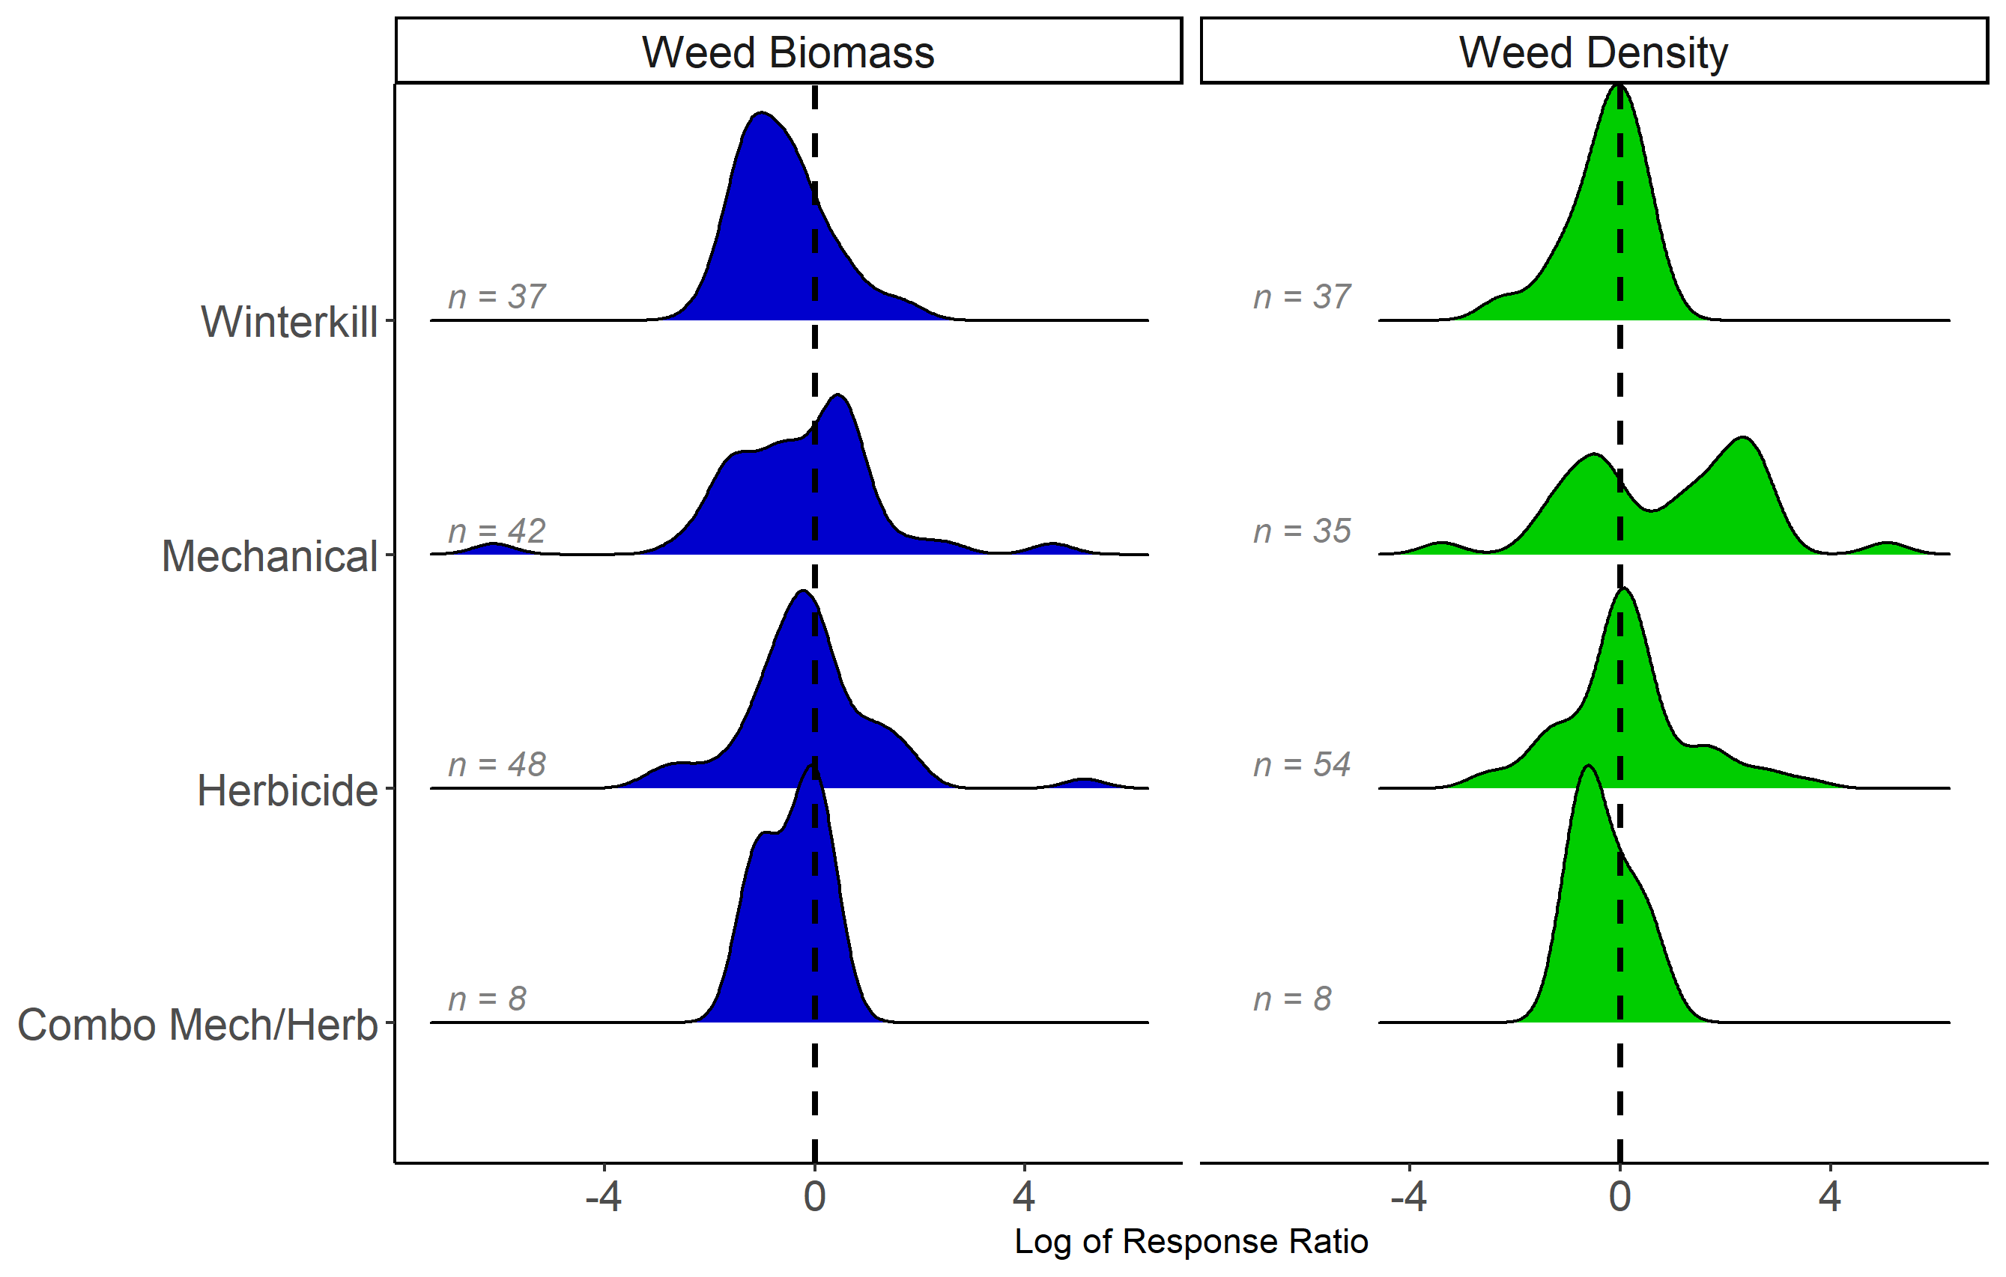


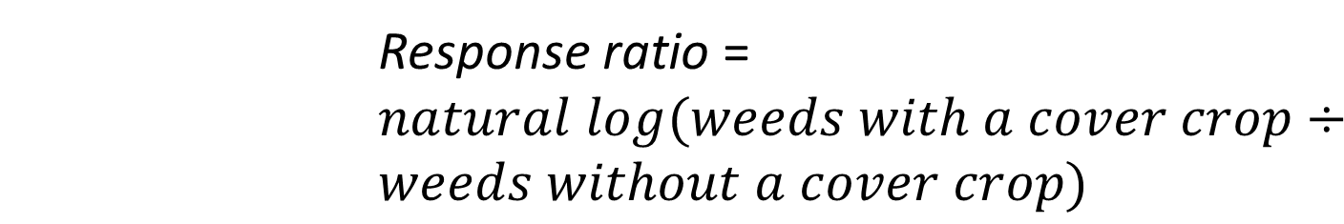
Do winter cover crops suppress weeds in Midwestern corn- and soybean-based systems?
A meta-analysis
Andrea Basche¹, David Weisberger², Virginia Nichols², Alisha Bower³, Chris Wilbeck³, Sarah Carlson³
1. University of Nebraska-Lincoln, Department of Agronomy and Horticulture, Lincoln, NE
2. Iowa State University, Department of Agronomy, Ames, IA
3. Practical Farmers of Iowa, Ames, IA
Rationale
Database Overview
The Midwestern U.S. has seen a modest increase in winter cover crop use over the past 10 years. However to reach water quality goals, it is estimated that adoption of cover crops will need to scale from 5% to more than 50% of cropland acres in this region. At the same time, their use may aid in reducing herbicide costs and in providing an alternative strategy for managing herbicide resistant weeds, both important cost savings that improve short-term economics. Presently, the degree to which cover crop type, fall planting date and spring termination method affect weed management is not well understood. Further, the quantity of cover crop biomass needed for a significant reduction in weeds is uncertain. To address these questions, we conducted a meta-analysis to quantify the effects of winter cover crops, and their management, on weeds. We included peer-reviewed studies in our database if they: (1) Were located within one of the major corn producing Midwestern states*; (2) Grew a fall seeded cover crop before corn or soybean; and (3) Measured and reported weed biomass or weed density.
.
State | Year | Cover crop species | Corn or soybean | Authors
OH | 1993 | vetch | corn | Hoffman et al.
MI | 2001 | clover, medic | corn | Fisk et al.
IL | 2002 | vetch | corn | Czapar et al.
OH | 2003 | wheat, vetch | corn, soybean | Gallagher et al.
MN | 2005 | rye | soybean | DeBruin et al.
IL | 2010 | rye, vetch | soybean | Davis et al.
WI | 2011 | rye | soybean | Bernstein et al.
IA | 2012 | mixes | corn, soybean | Delate et al.
MI | 2012 | rye/vetch, vetch | …* | Hayden et al.
IN | 2012 | wheat, ryegrass | corn, soybean | Mock et al.
MN | 2013 | rye | soybean | Forcella et al.
MN | 2016 | radish | corn | Gieske et al.
MO | 2017 | mixes* | soybean | Cornelius and Bradley
IL | 2017 | radish, canola, rye | soybean | Crawford et al.
NE | 2018 | rye | …* | Werle et al.
Locations of experiments (above) and meta-data (left). Only Illinois, Indiana, Iowa, Kansas, Michigan, Minnesota, Missouri, Nebraska, North Dakota, Ohio, South Dakota, and Wisconsin were potentially included because we were concerned with the continuous Corn Belt states in the Midwest with the greatest number of corn and soybean acres.
  Response ratio = $natural log(weeds with a cover crop÷weeds without a cover crop)$
Results
Objectives: 1) Quantify weed control from experiments in corn-soybean cropping systems in the Corn Belt using fall planted cover crops; 2) Identify cover crop management practices required to achieve optimal weed control
Weeds decreased in cc treatment
Weeds increased in cc treatment
Methods
Records identified through Web of Science keyword search = 676
Keyword search string: (weed* AND ("cover crop*" OR "green manure" OR "catch crop*") AND ("corn" OR "maize" OR "soybean*"))
(top) When experiments included yields we found that cover crops represented “win-win” scenarios 18% of the time where weeds were reduced and yields were increased.
(left) Greater levels of cover crop biomass tended to have a greater impact on weed control, particularly before corn.
Above: Response ratios represent the natural log of weeds (biomass or density) Cover crops decreased weed density in 48% of response ratios by a mean value of -3% (standard error 34%). Cover crops decreased weed biomass in 64% of response ratios by a mean value of -66% (standard error 34%).
Below: Winterkill, herbicide and dual methods of cover crop termination were more effective at suppressing weeds with cover crops, and our preliminary statistical analysis suggests that there are significant differences between these groups for both weed biomass and weed density. There was one notable study (DeBruin et al. 2005) where weed density was continually increased in the cover crop treatment when rye before soybean was mowed.
Records excluded = 456
Most common reason was that studies were clearly not relevant based on abstract/title
Full text articles screened for eligibility = 220
Full text articles excluded = 131 + x
Most common reasons: weeds were not measured; studies were not located in Corn Belt States*; did not include cropping systems or experimental design that would allow for a true control to experimental comparison; grew a spring vs. fall seeded cover crop
Additional Questions Generated
Are there interactions with cover crops and herbicides that make herbicides more or less effective?
How much biomass is needed to consistently reduce weeds?
How might a cover crop be creating a more favorable environment for weeds?
What is the difference in weed control in overwintering or winter killed cover crops?
How does a cover crop impact weed germination and emergence?
Articles included in qualitative synthesis ~ 16 review articles
Articles included in quantitative synthesis = 15 to date, ~x left for screening
PFI LOGO
Notes:
Notes: REVIEW ARTICLE – only three are the same, their focus was timing (early season – figs broken out this way, only 30% were herbicide termination methods)
Do we want to include a diagram of processes?
X number of new studies to add (maybe include a list?)
Why do cover crops increase weeds? Perhaps they are making soil more favorable.. Or tillage is turning over weed seeds – note that we do not have any tillage studies. They are all either mowing or crimping
What is the critical threshold of biomass?
How many organic systems do we have and are there differences?
Is it really biomass? Bc the herbicide is less effective? Or did mowing make weed germination better?

